Slide 1
C++ strings
Kusal Bista

Slide 2
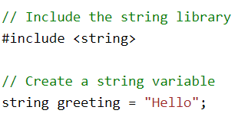

C++ Strings
Strings are used for storing text.

Slide 3
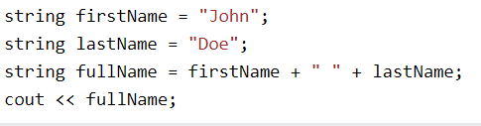
String Concatenation

Slide 4
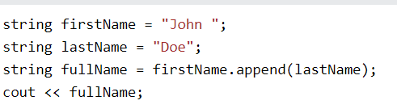
C++ Append

Slide 5

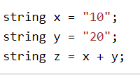
Adding Numbers and Strings
C++ uses the + operator for both addition and concatenation.
Numbers are added. Strings are concatenated.

Slide 6

C++ String Length
To get the length of a string, use the length() function:

Slide 7

C++ Access Strings
You can access the characters in a string by referring to its index number inside square brackets [ ].

Slide 8

Change String Characters

Slide 9
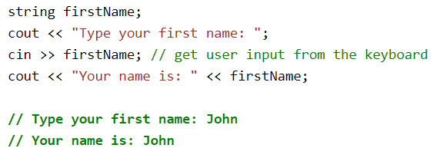
User Input Strings

Slide 10
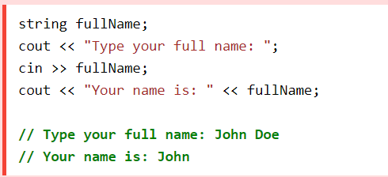
User Input Strings

Slide 11
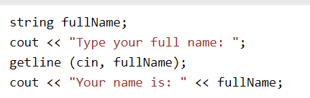
getline()

Slide 12
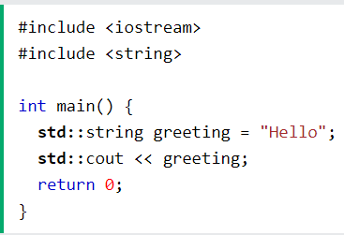
Omitting Namespace

